Slide 1
Product ArchitecturE
Max, Louis, Lukas, Christopher

Slide 2
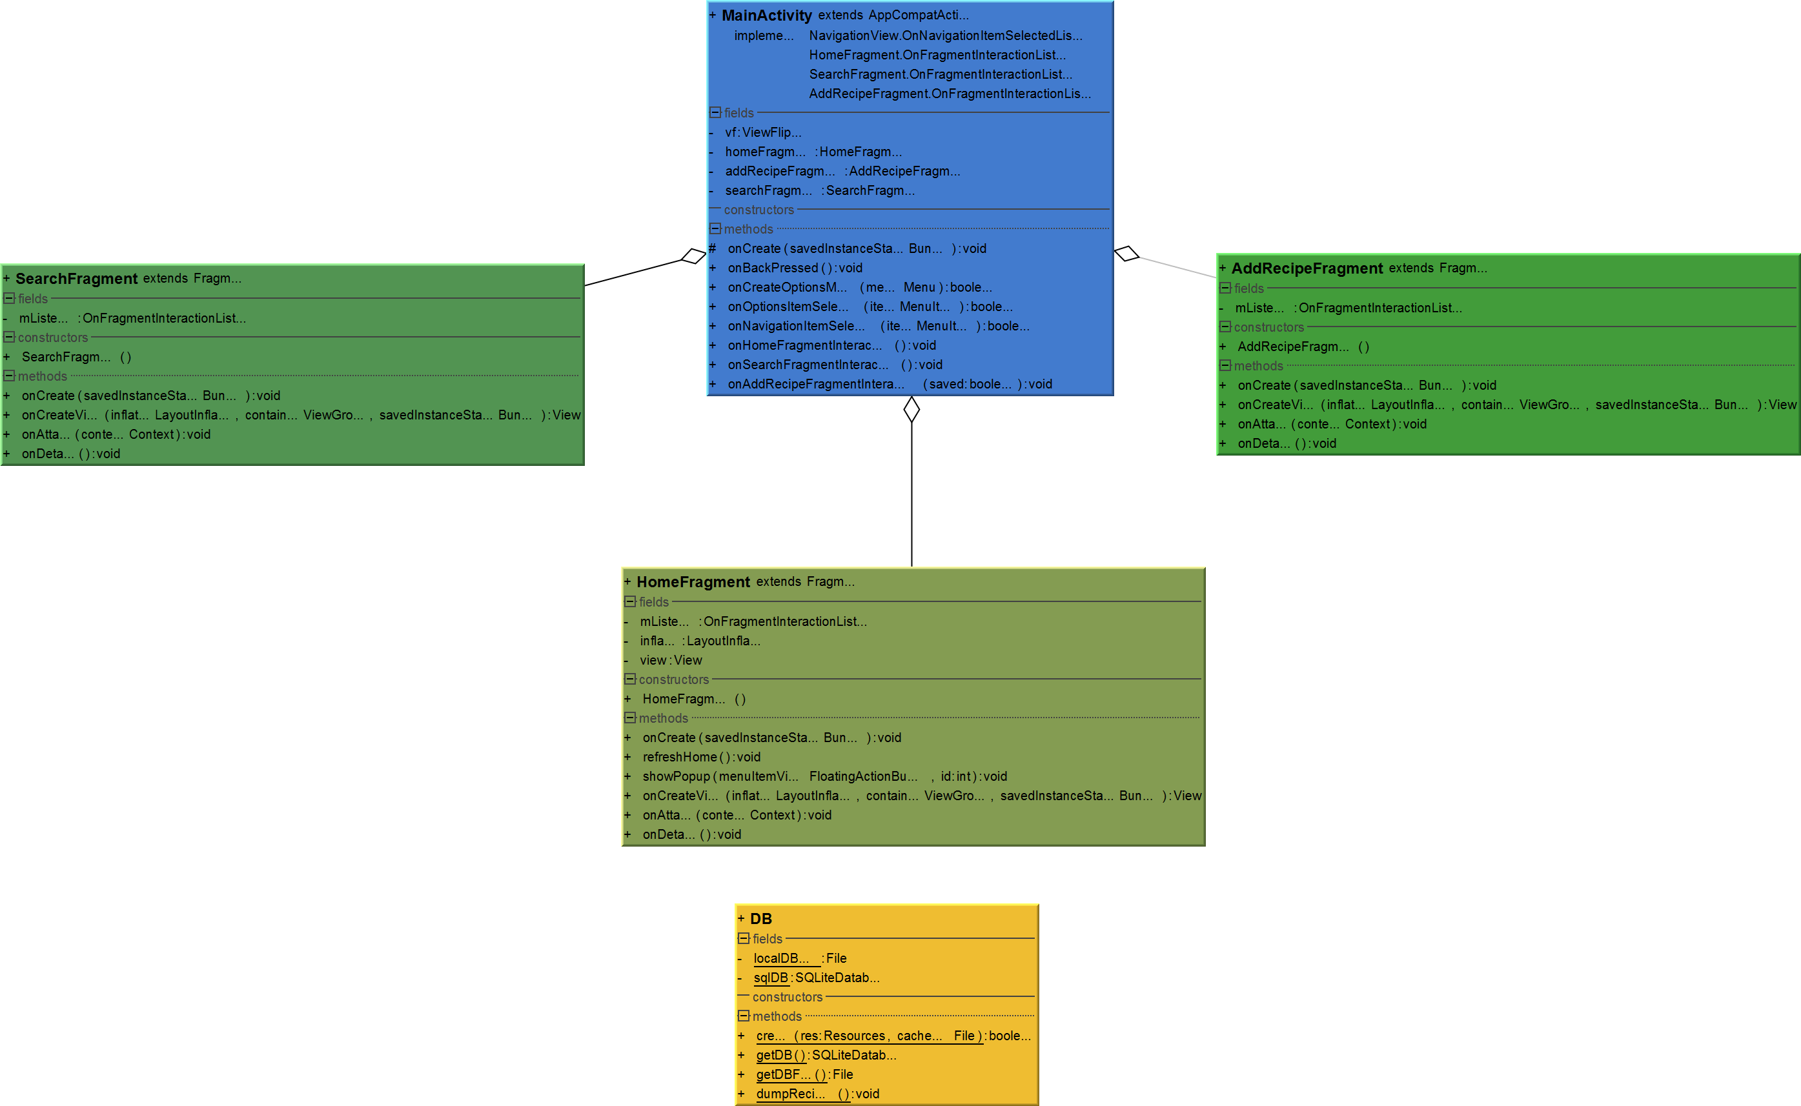
Simple Code Class Diagram

Slide 3
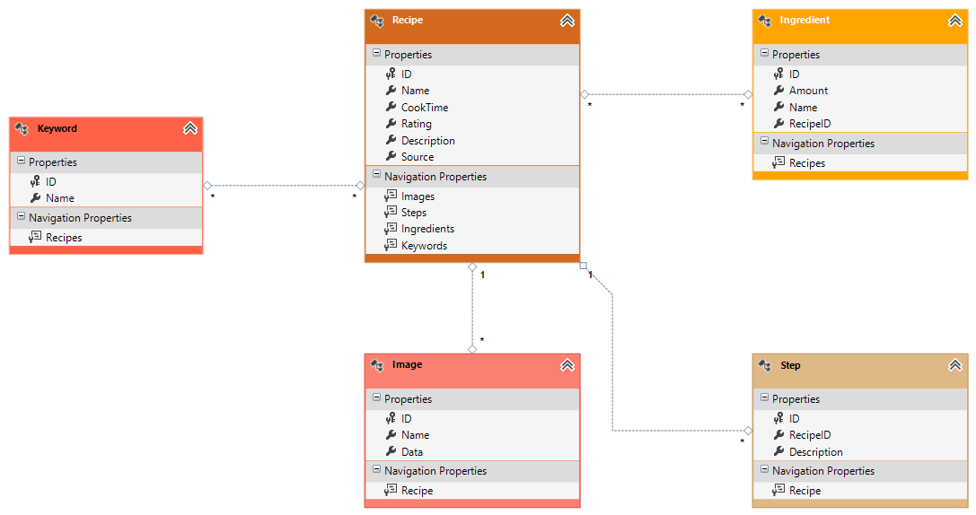
Database Class Diagram

Slide 4
System Boundaries
Pocket Chef
Add/Edit Recipe
Delete Recipe
Search Recipe
Edit Recipe
Backup/Restore Database

Slide 5
Context Model

Slide 6
Activity Diagram

Slide 7
Use Case 1

Slide 8
Use Case 2

Slide 9
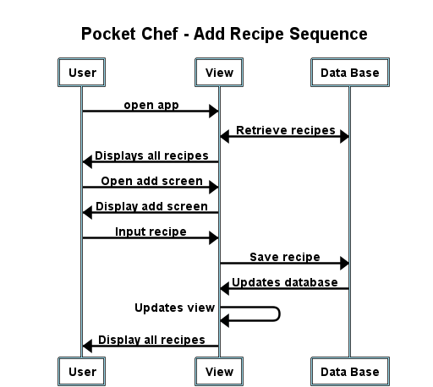
Add Recipe Sequence Diagram

Slide 10
State Diagram

